Slide 1
Index
Appium Mobile App Automation Testing
Slide no. | Subject
3) | Introduction to Appium
4) | Why Appium and its Use Cases
5) | Appium architecture diagram
6) | Screenshots of the project
7) | Merits and demerits of appium
8) | Conclusion

Slide 2
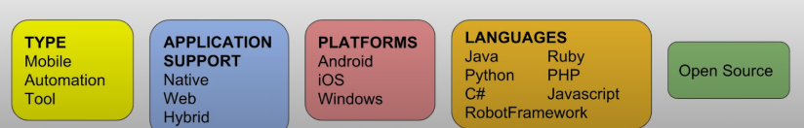
WHAT IS APPIUM?
Appium is an open source automated testing tool for mobile applications
Appium can be used to test native, web and hybrid mobile applications
Supports IOS, Android and windows desktop

Slide 3
Why Appium?
Automate functional tests for mobile apps.
Detect and resolve bugs early in the development process.
Ensure consistent performance across platforms.
Use Cases:
Regression testing.
Compatibility testing across devices and OS versions.
Testing mobile app features, including gestures and interactions.

Slide 4
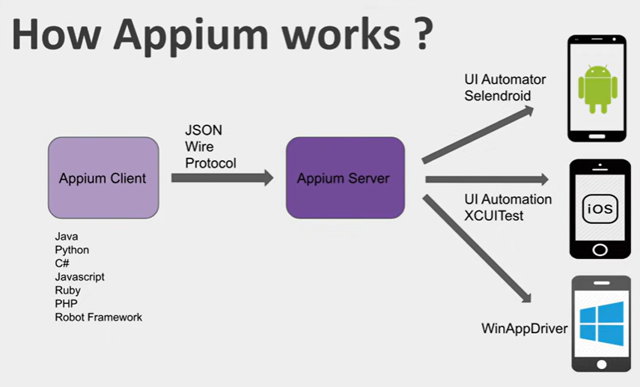

Slide 5
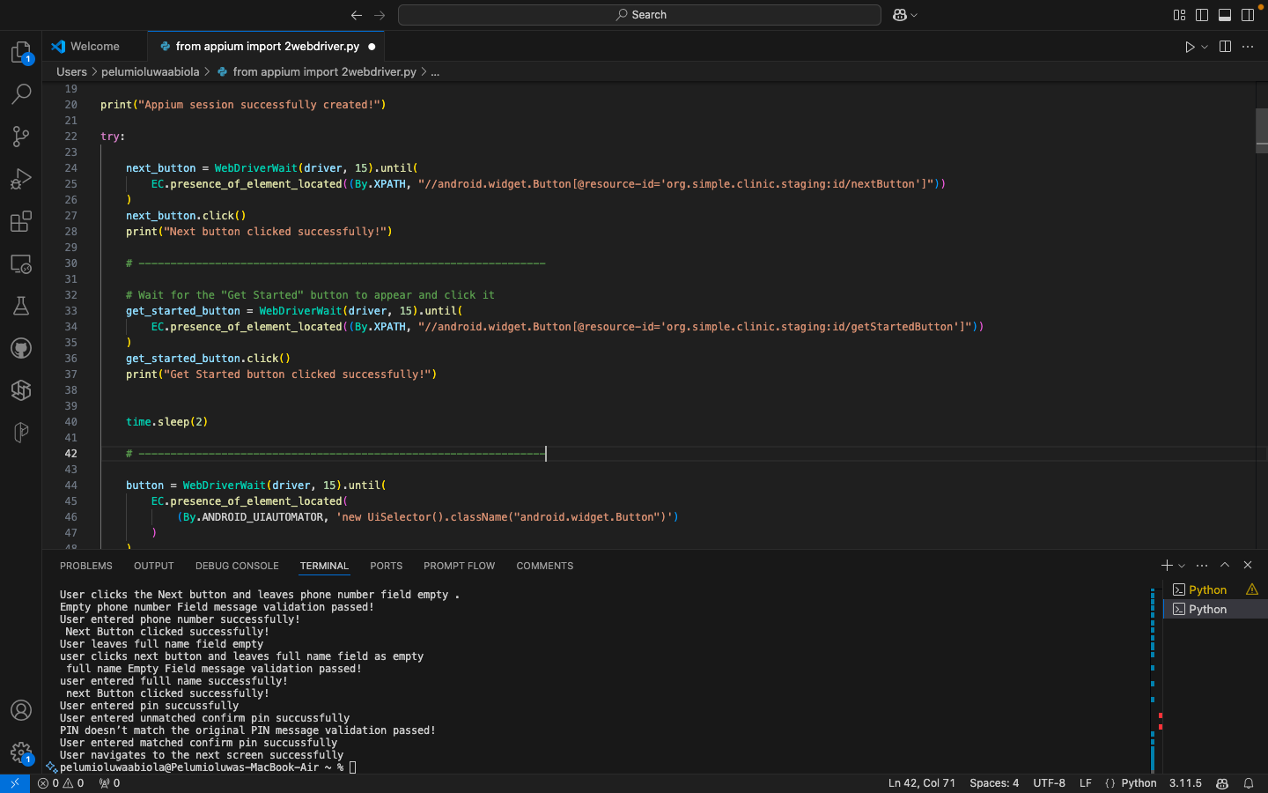
Screenshots of python scripts

Slide 6
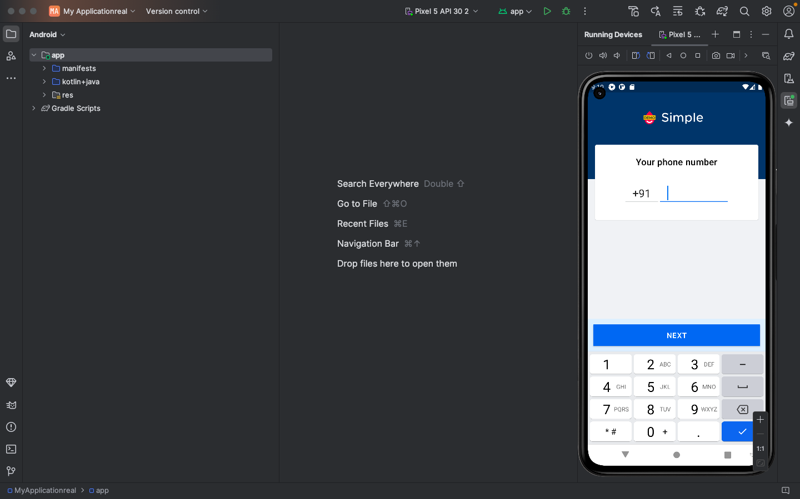
Screenshots of android emulator

Slide 7
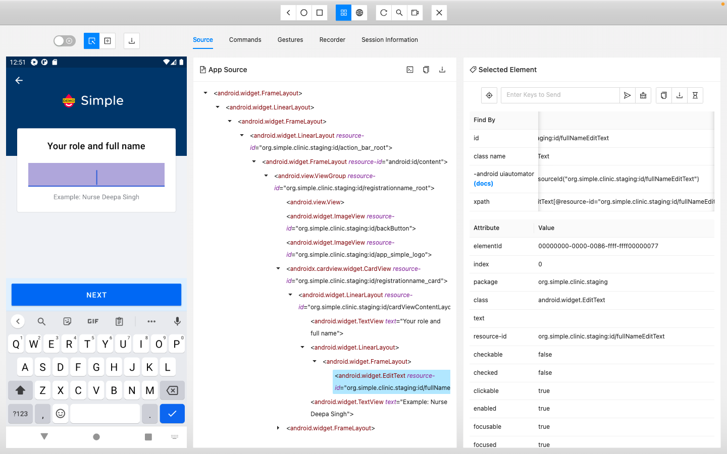
Screenshots of appium inspector

Slide 8
Merits of Appium
Cross-Platform Testing
No Need for App Modifications
Supports Multiple Languages
Open-Source
Extensive Mobile Device Support

Slide 9
Demerits of Appium
Complex setup
Slow test execution
Limited support for desktop applications
Lower advance features
Flaky Tests and Limited Support for Certain Mobile Features

Slide 10
Conclusion
Appium works based on a client-server model where test scripts (client) communicate with the Appium server, which in turn interacts with mobile devices (real or emulated) through platform-specific drivers.
These components work in tandem to automate mobile app testing and allow for cross-platform automation using a single codebase.
Each component's responsibility ensures that Appium can execute automated tests on both Android and iOS devices with minimal effort from the tester’s side.

